Slide 1
Changzhou haolilai Photo-Electricity Scientific and Technical Co.,Ltd
HLL is a long-term focus R&D and manufacturing of high precision of optics. With more than 20 years of experience in the production of laser optics, auto optics and optics for semiconductor industry, we received highly customer satisfaction rate around the world.

Slide 2
Founded in 1998, HLL is located in national level High-tech Development District, Changzhou, Jiangsu ,China. It’s neighboring Shanghai-Nanjing expressway on the north, Changzhou high speed railway station on the east, Changzhou airport on the west. HLL covers an area of 30,000m2 and has passed the system certification such as ISO9001:2015, ISO14001:2015, and IATF16949.
As a High-Tech enterprise of Jiangsu province, HLL boasts a talent team with intensive experience and first-class technology . HLL has established Jiangsu Precision Optical Lens Engineering Technology Center and Jiangsu Enterprise Technology Research Center and obtained multiple patents for inventions, multiple utility model patent and multiple Jiangsu High New Tech Product.
HLL mainly develops and produces various precision optical components.Focus on laser optics, auto optics , semiconductor industry and consumer optics.HLL will strive to become a benchmark in China's optical industry.
企业简介
COMPANY INTRODUCTION
公司成立于1998年，位于常州市（国家级）高新技术开发区，北靠沪 宁高速公路，东临常州高铁站，西近常州国际机场，占地30000多平方米，并通过 了ISO9001:2015、ISO14001:2015 、IATF16949 等体系认证。
公司是江苏省高新技术企业，拥有经验丰富、技术一流的人才队伍；建 立了江苏省精密光学镜片工程技术中心、江苏省企业技术研究中心；拥有多项发明专利、多项实用新型专利、多个江苏省高新技术产品。
公司主要研发和生产各类精密光学元器件，产品广泛应用于消费类光学、车载光学、激光光学、半导体等领域，努力打造成为中国光学行业的标杆。

Slide 3
HLL 公司成立，主要生产各类球面透镜。
HLL was established in 1998, mainly produces various types of spherical lenses.
1998
2006
新厂房投入使用并通过IS09001:2004 体系认证。
Move to the new plant and pass the system certification of lS09001:2004.
历史沿革Compan y Company History
2008
通过ISO14001:2008 体系认证。
Pass the system certification of ISO14001:2008.
申报4-6英寸蓝宝石衬底基片及其制备技术项目，被评为江苏省民营科技企业。
Apply for 4-6 inch sapphire wafer and its manufacturing technology project.Been identified as Jiangsu Private Technology Company.
2009
获得 5 项发明专利、1项实用新型专利，2个常州市高新技术产品、1个江苏省高新技术产品，建立江苏省精密光学镜片工程技术研究中心。
Obtain 5 invention patents, One utility model patent2 new products been Identified as High-tech products of Jiang su and 1 new product been identified as High-tech products of Chang zhou.Jiang su precision optical lens Engineering Research Center was established.
2011

Slide 4
获得 2个江苏省高新技术产品，申报 2-6 英寸蓝宝石衬底片精密制造技术市支撑项目，被评为江苏省高新技术企业。
2 new products been Identified as High-tech products of Jiangsu Apply for 2-6 inch sapphire wafer precision manufacturing technology project.Been identified as Jiangsu High New Tech Enterprise.
2012
获得4项江苏省高新技术产品，申报超光滑表面蓝宝石晶片半导体照明技术开发与应用- 市支撑项目。
4 new products been ldentified as High-tech products of Jiangsu;Apply for the development and application of ultra-smooth surface sapphire wafer semiconductor lighting technology project .
2014
历史沿革Compan y Company History
扩大了蓝宝石晶圆生产线产能；新增了玻璃晶圆、石英晶圆生产，获得1项江苏省高新技术产品申报：大尺寸超薄半导体晶圆的联合研发-国际合作项目。
Expand the sapphire wafer production and start produce glass wafer and fused silicawafer;1 new product been identified as High-tech products of Jiangsu; Apply for joint research and development of large-size ultra-thin semiconductor wafers - international cooperation project.
2018
获得1项常州市高新技术产品；申报大尺寸光学半导体晶圆的研发- 市支撑项目。
1 new product been identified as High-tech products of Changzhou. Apply for large size optical semiconductor wafer R&dD project.
2020
2022
通过IS09001:2015、ISO14001:2015换证审核和IATF16949:2016体系认证。
Pass IS09001:2015, ISO14001:2015 certification review, and IATF16949:2016 system certification.

Slide 6
应用领域
APPLICATION
消费类光学
Consumer Optics
半导体
Semiconductor
激光光学
Laser Optics
车载光学
Auto Optics

Slide 7
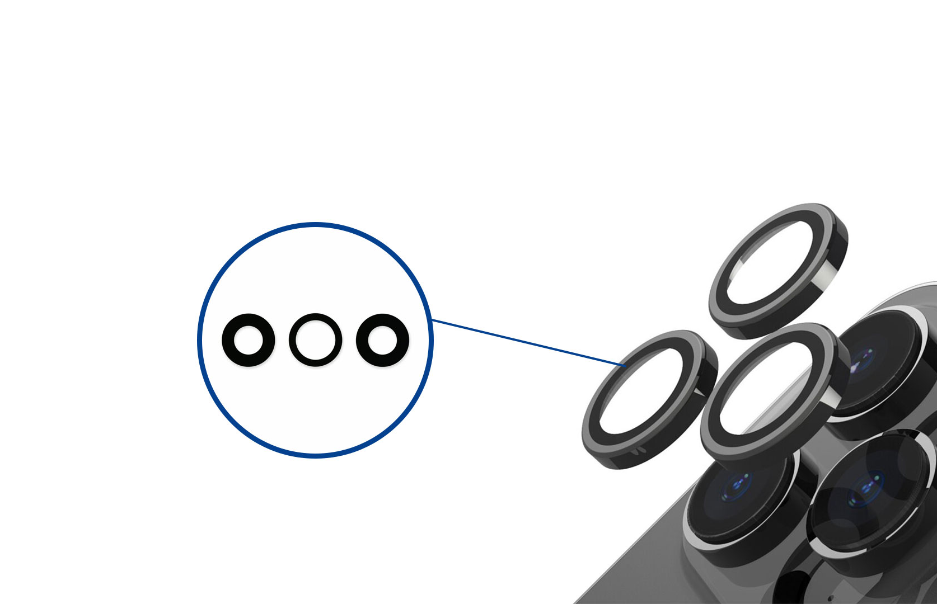
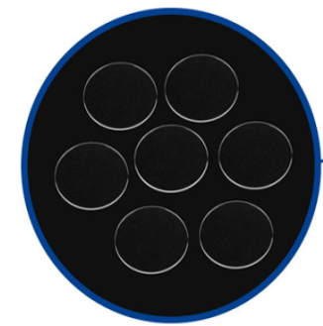
消费类光学领域
Consumer Optics
智能手机
Smartphone
镜头保护窗基片
LENS PROTECTION WINDOU SUBSTRATE

Slide 8
消费类光学领域
Consumer Optics
智能手表
SmartWatch
感应器窗口基片
SENSOR WINDOW SUBSTRATE
穿戴表盖
WATCH FACE

Slide 9
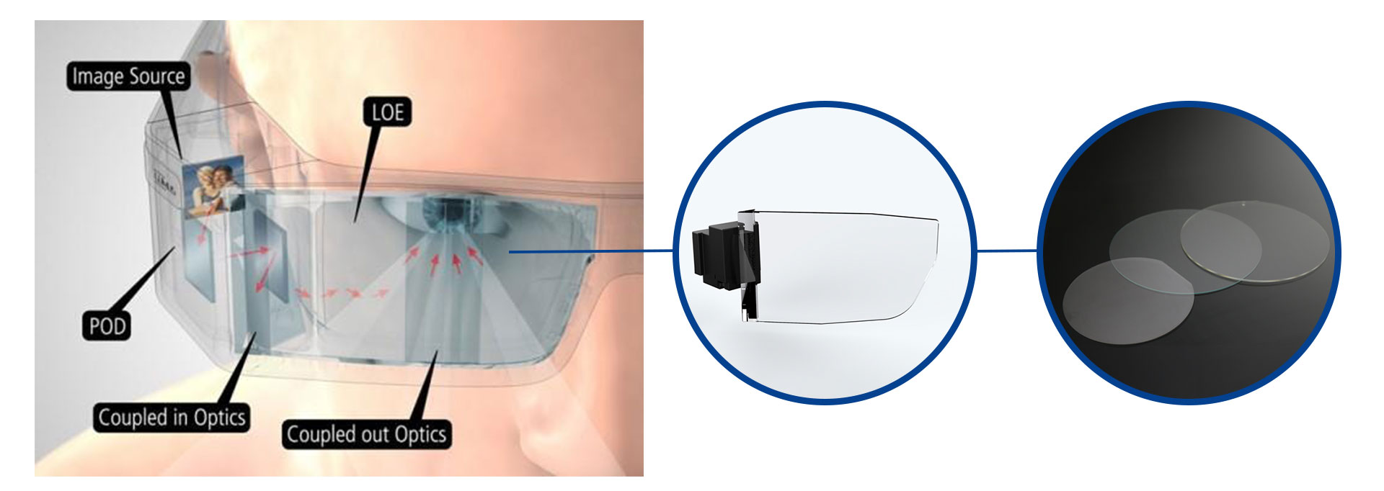
消费类光学领域
Consumer Optics
AR眼镜
Augmented Reality
玻璃晶圆
GLASS WAFER

Slide 10
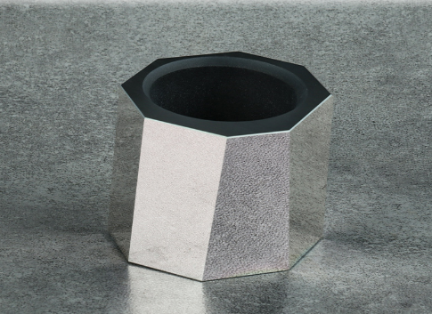
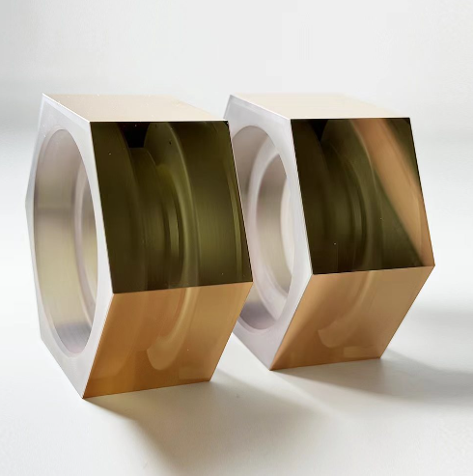
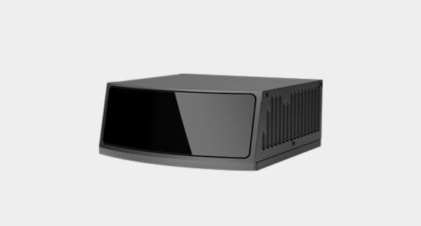
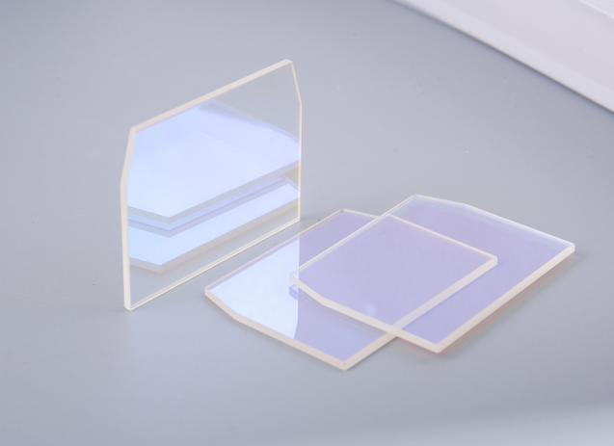
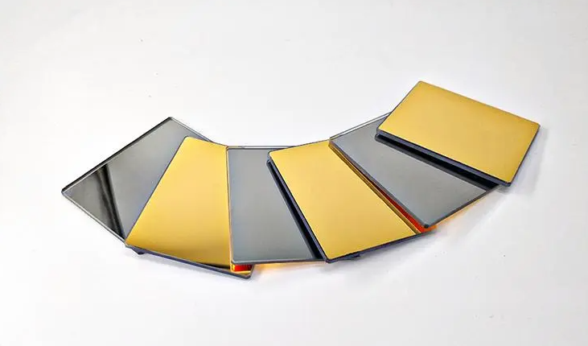
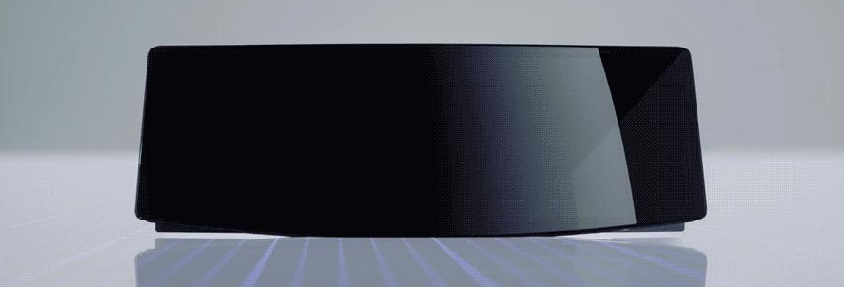
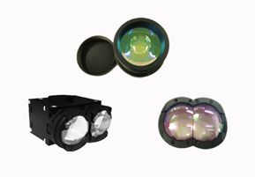
转镜ROTATING LENS
反射镜、滤光片、窗口
MIRROR，FILTER，WINDOW
镜头LENS
激光雷达
车载光学领域
窗口WINDOWS
Laser Radar
Auto Optics

Slide 11
激光投影镜头
LASER PROJECTION LENS
车载投影大灯
车载光学领域
Digital Light
Auto Optics

Slide 12
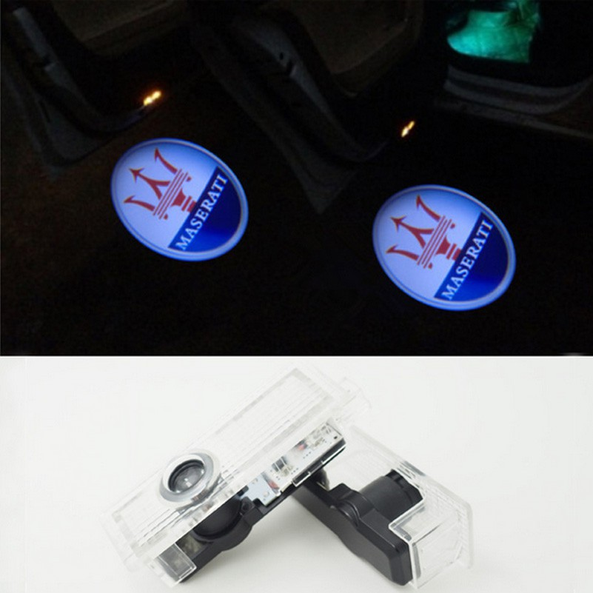
迎宾灯、凤尾灯
车载光学领域
Illuminayed Entry System
Auto Optics

Slide 13
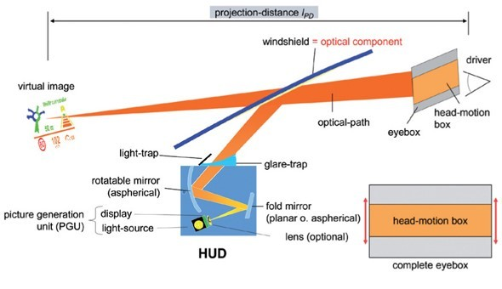
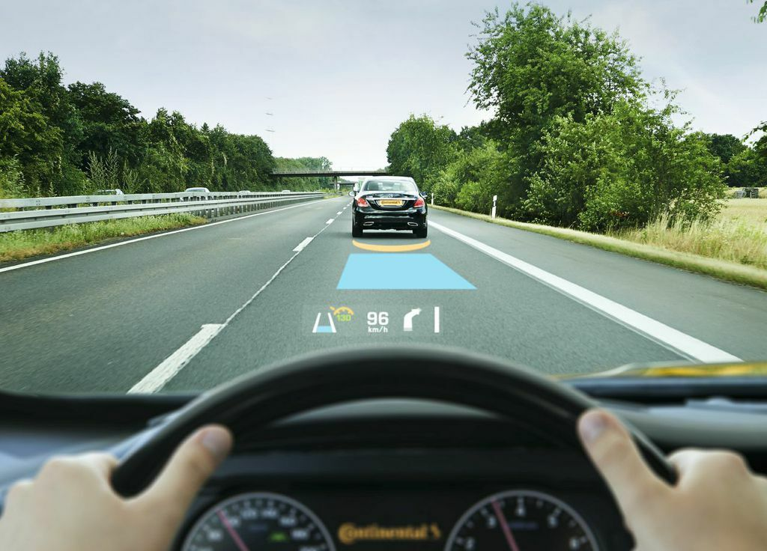
反射镜
MIRROR
车载HUD
车载光学领域
HeadUp Display
Auto Optics

Slide 14
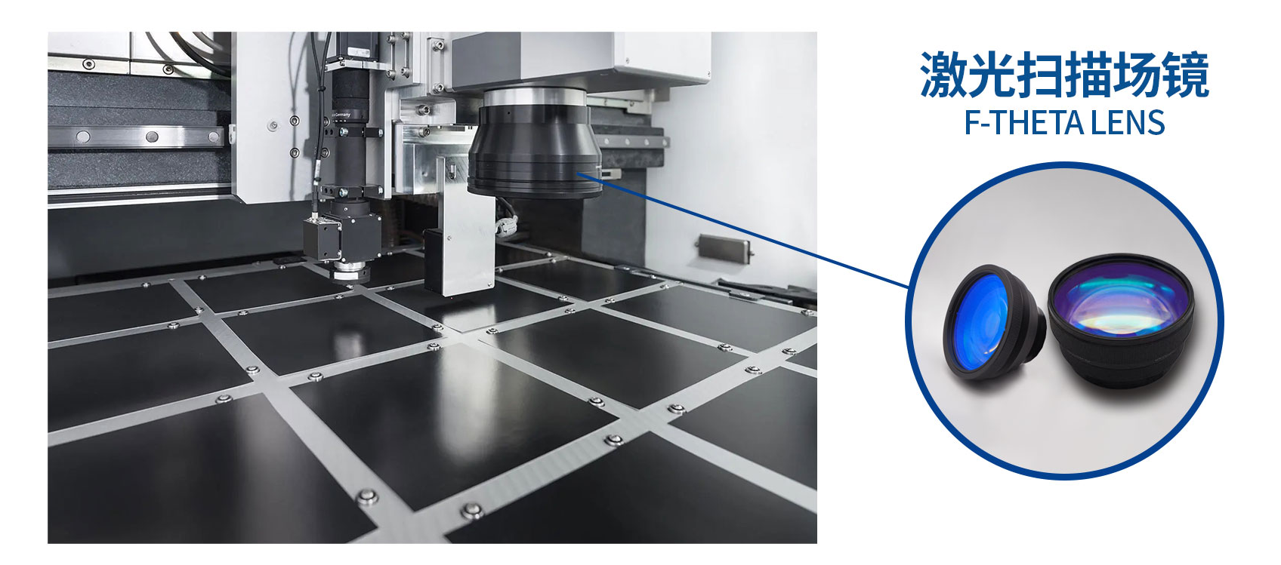
激光光学领域
Laser Optics
激光扫描场镜
Laser Scanning

Slide 15
激光光学领域
Laser Optics
激光器
Laser
反射镜
MIRROR
滤光片
FILTER

Slide 16
激光光学领域
Laser Optics
激光切割头
Laser Cutting
各类光学镜片
VARIOUS OPTICAL LENSES

Slide 17
蓝宝石晶圆
SAPPHIRE WAFER
微型LED显示
半导体领域
Micro LED display
Semiconductor

Slide 18
石英晶圆
QUARTZ WAFER
微传感系统
Micro Electric Mechanical System
半导体领域
Semiconductor

Slide 20
光学窗口片
Optical Window
有色玻璃滤光片
Color Glass Filter




Slide 21
光学窗口片参数
Technical parameters of optical window
形状分类 Shape | 圆形 Round | 可生产加工范围 外径范围：2-400mm 厚度范围：0.1-30mm（蓝宝石和石英） 0.2-30mm（玻璃窗口） Dimension Outer diameter：2-400mm Thickness：0.1-30mm(Sapphire and quartz window) 0.2-30mm （Glass window）
 | 方形/长方形/矩形 Square /Rectangular | 可生产加工范围 长度范围：2-400mm 宽度范围：2-400mm 厚度范围：0.1-30mm(蓝宝石和石英窗口） 0.2-30mm（玻璃窗口） Dimension Length：2-400mm Width： 2-400mm Thickness：0.1-30mm（Sapphire and quartz window） 0.2-30mm (Glass window)
 | 异形件 Other Shape | 可根据客户需求定制生产 Customized




Slide 22
形状分类 Shape | 圆形 Round | 可生产加工范围Dimension 外径范围：2-400mm 厚度范围：0.5mm Outer diameter：2mm Thickness：0.5mm
 | 方形/长方形 Square /Rectangular | 可生产加工范围Dimension 长度范围：200-400mm 宽度范围：200-400mm 厚度范围：0.5-30mm Length：200-400mm Width：200-400mm Thickness：0.5-30mm
 | 方形（蓝玻璃）/定制 Square(blue glass)/Customized | 可生产加工范围 Dimension 长度范围：77mm 宽度范围：77mm 厚度范围：0.1-0.5mm Length：77mm Width：77mm Thickness：0.1-0.5mm



有色玻璃滤光片参数
Technical parameters of color glass filter

Slide 23
材 料 Material | 光学玻璃 ,蓝宝石，熔融石英 Optical glass, Sapphire , fused silica
外形公差 Dimension tolerance | +/-0.03mm
厚度公差 Thickness tolerance | ±0.005mm
面 型 Flatness | ≤1/8λ，@632.8 nm
平行度 Parallelism | ≤1'
光 洁 度 Surface quality | 5/10；20/10；40/20，60/40
有效孔径 Clear aperture | >90%
镀膜 Coating | AR/AF/IR/dielectric film/metal film/laser film



光学窗口片参数
Technical parameters of optical window

Slide 24
石英 / 玻璃 / 蓝宝石晶圆
Quartz Wafer & Glass Wafer& Sapphire Wafer




Slide 25
规格 Property | 4 inch | 5 inch | 6 inch | 8 inch
直径 Diameter | 50.8 ± 0.1 mm | 100 ± 0.1 mm | 150 ± 0.1 mm | 200 ± 0.1 mm
厚度 Thickness | 430 ± 25 um 或定制 or customized | 500 ± 5 um 或定制 or customized | 650 ± 25 um 或定制 or customized | 1300 ± 25 um 或定制 or customized
粗糙度 Roughness | Ra≤0.3 nm Ra≤0.3nm Ra≤0.3nm Ra≤0.3nm
翘曲度 Warp | ≤ 10um ≤ 10um ≤ 10um ≤ 10um
总厚度偏差 TTV | ≤ 3 um ≤ 3 um ≤ 3 um ≤ 3 um
表面质量 Scratch/Dig. | 20/10 20/10 20/10 20/10
表面状态 Polish | 双面抛光; 单面抛光 DSP (Double Side Polished); SSP(Single Side Polished)
形状 Shape | 圆形, 带定位边 Round, Flat
倒边 Bevel | 45°,C Shape
材质 Material | 蓝宝石晶体 Sapphire crystal
备注 Remarks | 蓝宝石晶圆可定制 All specifications above can be customized upon your request



蓝宝石晶圆
Sapphire wafer

Slide 26
规格 Property | 4 inch | 5 inch | 6 inch | 8 inch | 12 inch
直径 Diameter | 100 ± 0.1 mm | 125 ± 0.1 mm | 150 ± 0.1 mm | 200 ± 0.1 mm | 300± 0.1 mm
厚度 Thickness | 500 ± 5 um 或定制 or customized | 625 ± 5 um 或定制 or customized | 675 ± 5 um 或定制 or customized | 725 ± 5 um 或定制 or customized | 900± 5 um 或定制 or customized
粗糙度 Roughness | Ra ≤ 1 nm Ra ≤ 1 nm Ra ≤ 1 nm Ra ≤ 1 nm Ra ≤ 1 nm
翘曲度 Warp | ≤ 10um ≤ 10um ≤ 10um ≤ 10um ≤ 10um
平整度 TTV | ≤ 3 um ≤ 3 um ≤ 3 um ≤ 3 um ≤ 3 um
表面质量 Scratch/Dig. | 20/10 20/10 20/10 20/10 20/10
形状 Chipping | 圆形；带定位边；带定位角 Round, Flat, Notch
倒边 Bevel | 45°, SEMI Spec; C Shape
材质 Material | Sodalime, Pyrex, Borofloat, Borosilicate (D263T),Corning eagle XG, BK7, and etc.
备注 Remarks | 玻璃晶圆可定制 All specifications above can be customized upon your request



玻璃晶圆
Glass wafer

Slide 27
规格 Property | 4 inch | 5 inch | 6 inch | 8 inch | 12 inch
直径 Diameter | 100 ± 0.1 mm | 125 ± 0.1 mm | 150 ± 0.1 mm | 200 ± 0.1 mm | 300 ± 0.1 mm
厚度 Thickness | 500 ± 5 um 或定制 or customized | 625 ± 5 um 或定制 or customized | 675 ± 5 um 或定制 or customized | 725 ± 5 um 或定制 or customized | 725 ± 5 um 或定制 or customized
粗糙度 Roughness | Ra ≤ 1 nm Ra ≤ 1 nm Ra ≤ 1 nm Ra ≤ 1 nm Ra ≤ 1 nm
翘曲度 BOW | ≤ 10um ≤ 10um ≤ 10um ≤ 10um ≤ 10um
平整度 TTV | ≤ 3 um ≤ 3 um ≤ 3 um ≤ 3 um ≤ 3 um
表面质量 Scratch/Dig. | 20/10 20/10 20/10 20/10 20/10
形状 Shape | 圆形, 带定位边, 带定位角Round, Flat, Notch
倒边 Bevel | 45°, SEMI Spec; C Shape
材质 Material | Corning, Nikon, Heraeus etc.
备注 Remarks | 石英晶圆可定制 All specifications above can be customized upon your request



石英晶圆
Quartz wafer

Slide 28
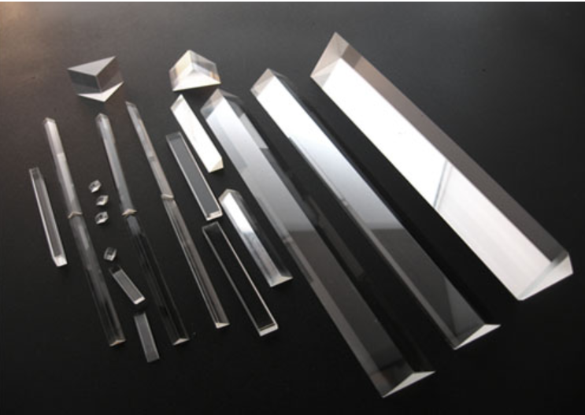
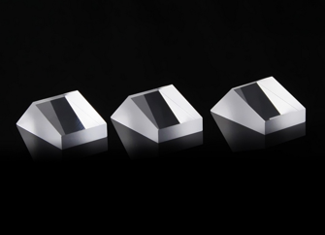
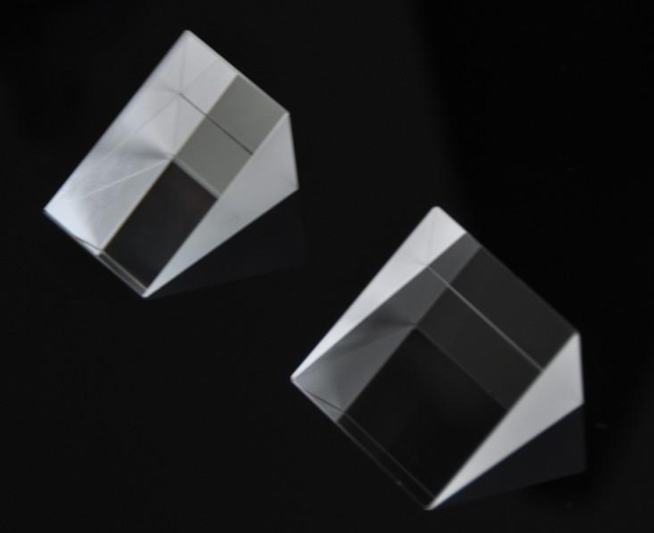
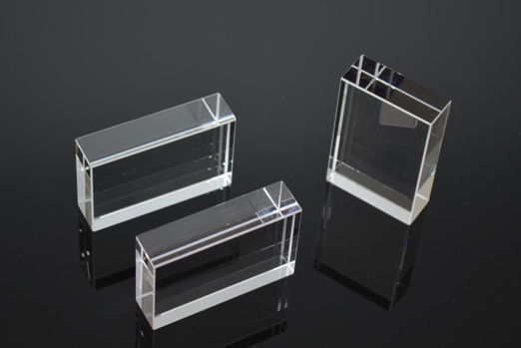

棱 镜
Prism



Slide 29
材 料 Material | 光学玻璃 ，熔融石英、蓝宝石 Optical glass, fused silica ,sapphire
尺寸 Dimension | 2~420mm
尺寸公差 Dimension tolerance | +/-0.01mm
角度公差 Angle tolerance | 90°+/-1", others+/-30"~+/-3'
平行度 Parallelism | 1'~5'
面型 Surface accuracy | N=0.5, △N=0.1
光 洁 度 S/D | 5/10；20/10；40/20，60/40
倒边 Chamfer | C0.1mm, 45°
镀膜 coating | AR/AF/IR/dielectric film/metal film/laser film



棱镜参数
Prism Parameters

Slide 30
光学透镜系列
LASER PROJECTION LENS
拥有较强的加工能力和先进的工艺水平，月生产能力达300万片，球面零件的加工口径范围D2-D200，零件曲率半径范围R1.9~R∞
The compary has strong processing capacity(monthly capacity:300milion pieces)and advanced technological level.The process caliber range of sphericalparts φ2-$200.The range of part radius ofcurvature: R1.9-R~
光学透镜系列
公司拥有较强的加工能力合和先进的工艺水平，月生产能力达300万片，球面零件的加工口径范围D2-D200，零件曲率半径范围R1.9~R∞
The compary has strong processing capacity(monthly capacity:300milion pieces)and advanced technological level.The process caliber range of sphericalparts φ2-$200.The range of part radius ofcurvature: R1.9-R~

Slide 31
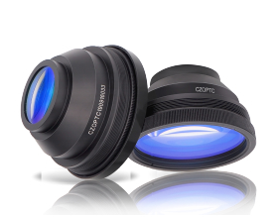
激光扫描场镜
LASER PROJECTION LENS

Slide 32
激光扫描场镜参数
Parameters of F-Theta lens
产品编号 Item No | 焦距 EFL | 扫描范围 Scan area mm | 波段 Wave mm | 入瞳直径 Extrance pupil dia mm | 光斑直径 Spot dia mm | 螺纹 Thread
1064-110-160 | 160 | 110x110 | 1064 | 12(10) | 20un | M85xl
1064-150-210 | 210 | 150x150 | 1064 | 12(10) | 25um | M85xl
1064-175-254 | 254 | 175x175 | 1064 | 12(10) | 30un | M85xl
1064-200-290 | 290 | 200x200 | 1064 | 12(10) | 32uii | M85xl
1064-300-430 | 430 | 300x300 | 1064 | 12(10) | 45u« | M85xl
1064-450-580 | 580 | 450x450 | 1064 | 18(10) | 50un | M85xl

Slide 33
激光扫描场镜参数
Parameters of F-Theta lens
产品编号 Item No | 焦距 EFL mm | 扫描范围 Scan area mm | 波段 Wave mm | 入瞳直径 Extrance pupil dia mm | 光斑 Spot diaum | 螺纹 Thread
355-100-160 | 355 | 60x60 | 160 | 10(8) | 15 | M85xl
355-100-160B | 355 | 110x110 | 160 | 10⑻ | 15 | M85xl
355-150-210 | 355 | 150X1S0 | 210 | 10(8) | 20 | M85xl
355-175-254 | 355 | 175x175 | 254 | 10⑻ | 25 | N85X1
355-200-290 | 355 | 200x200 | 290 | 10⑻ | 30 | N85xl
355-220-330 | 355 | 200x200 | 330 | 10(8) | 30 | MSxl
355-300-430 | 355 | 300x300 | 430 | 10(8) | 40 | M85xl
355-2X | 355 | 2 | 10-20 | 5 |  | M22*0.75 Straight
355-4X | 355 | 4 | 10-20 | 4 |  | M22*0.75 Straight
355-6X | 355 | 6 | 10-20 | 4 |  | M22-0.75 Straight
355-8X | 355 | 8 | 10-20 | 3 |  | M22-0.75 Straight
355-10X | 355 | 10 | 10-20 | 1.8 |  | M22*0.75 Straight
355-12X | 355 | 12 | 10-20 | 1.5 |  | M22-0.75 Straight

Slide 34
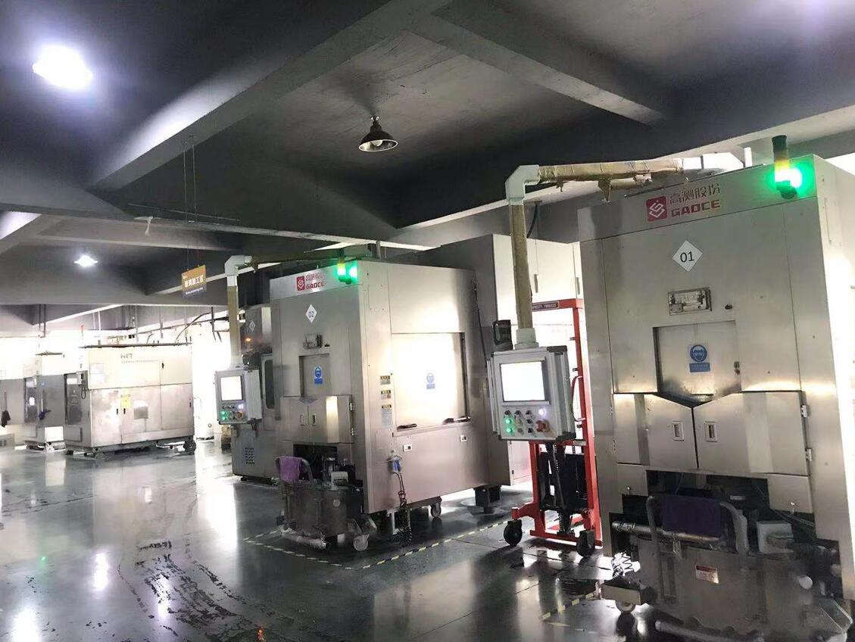
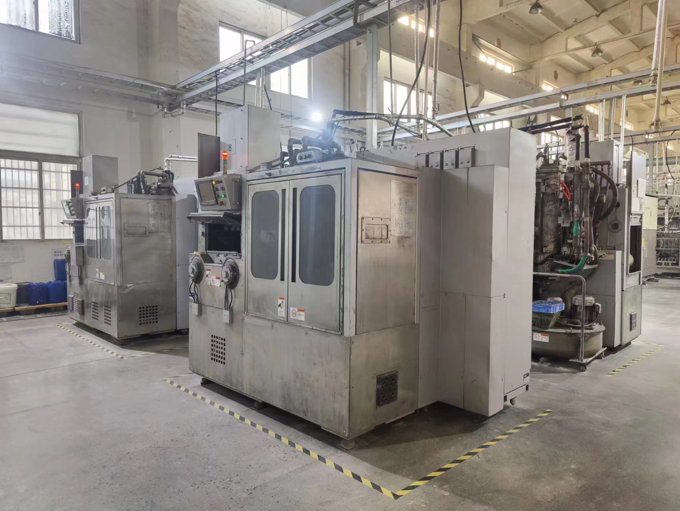
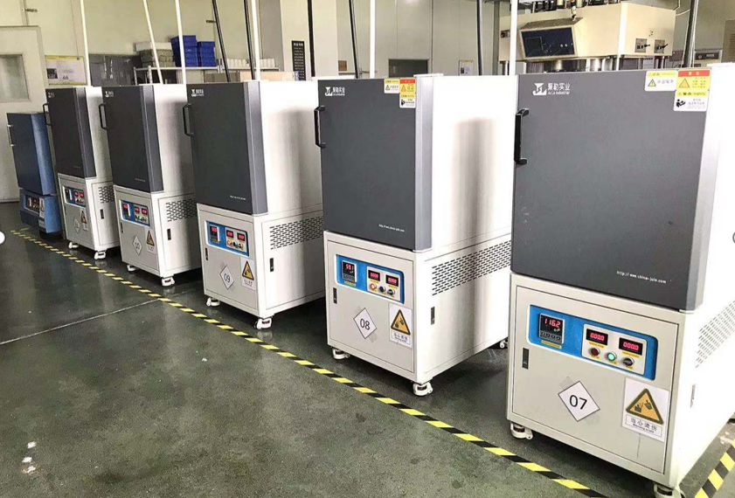
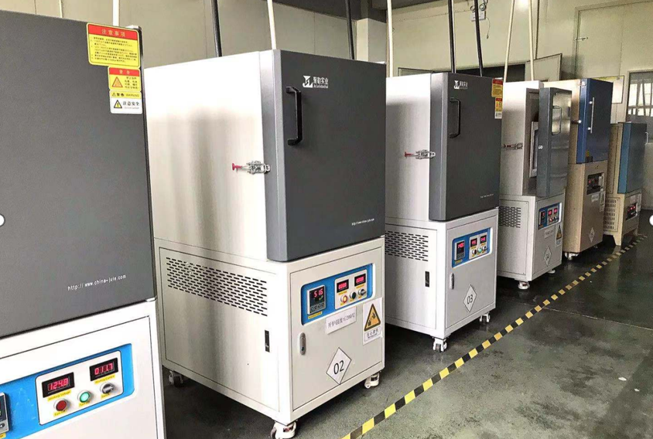
切割&退火
Sawing&Annealing

Slide 35
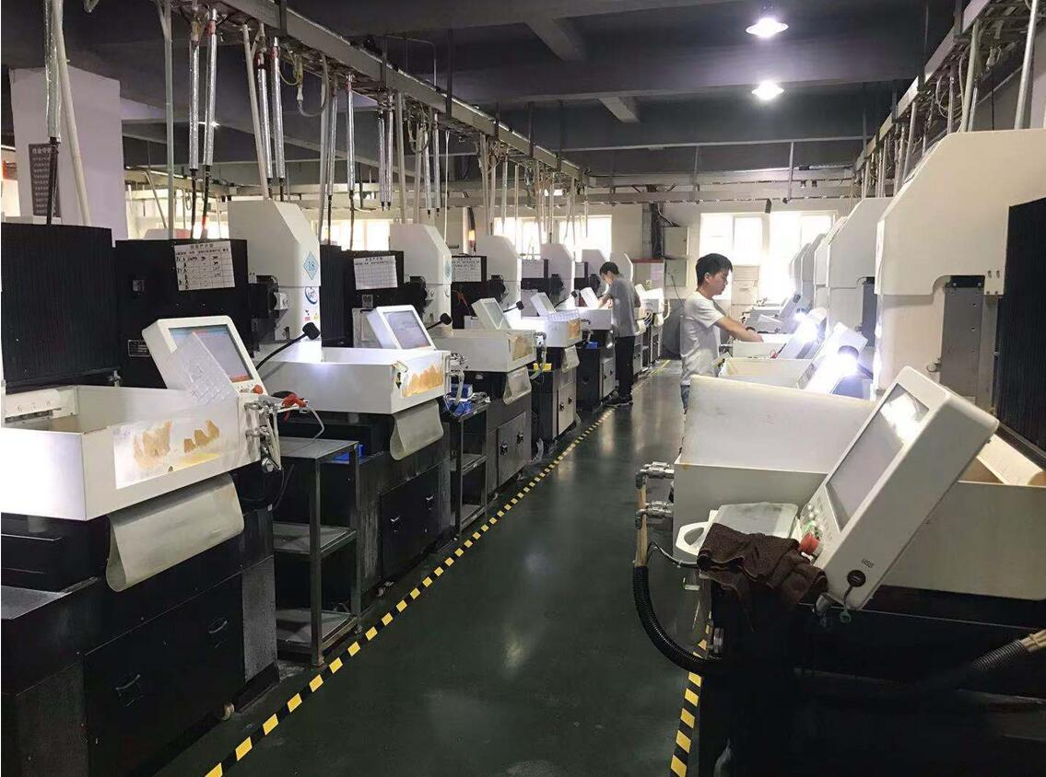
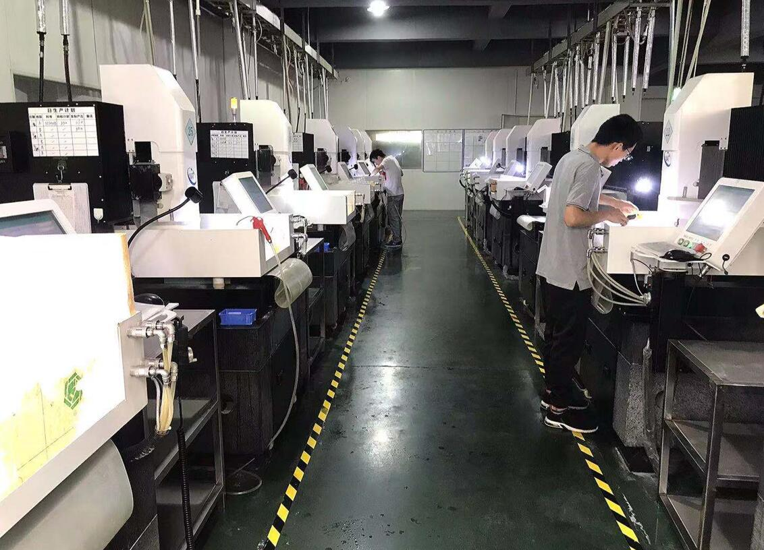
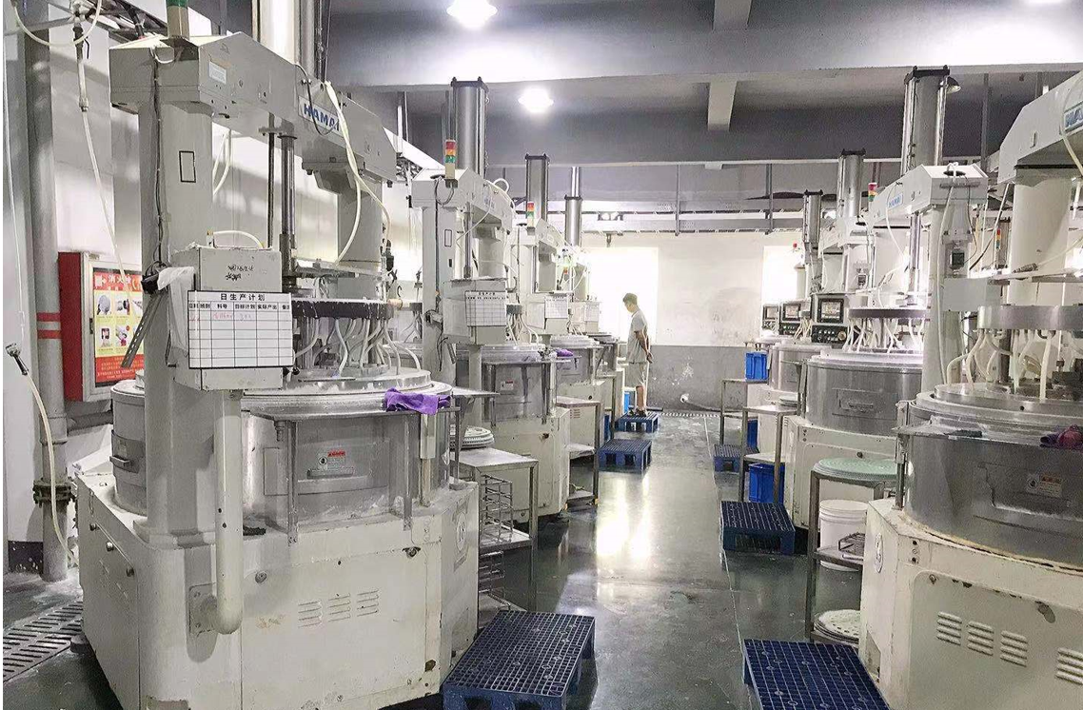
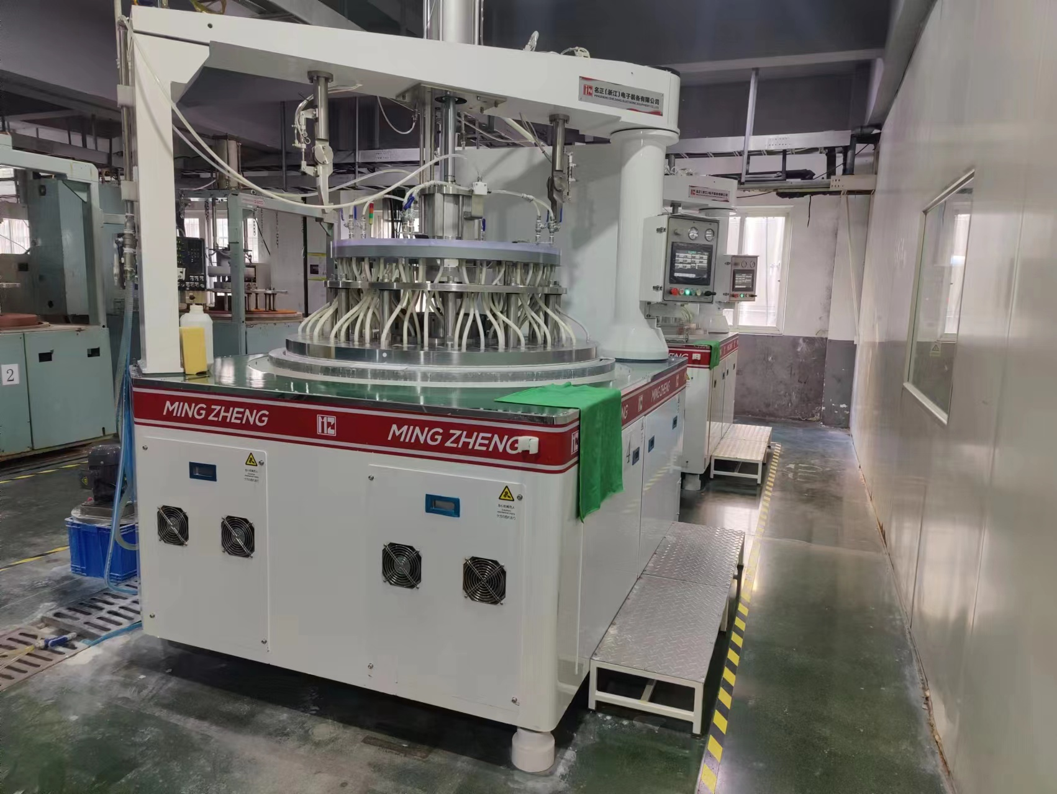
倒角& 研磨
Chamfering&Grinding

Slide 36
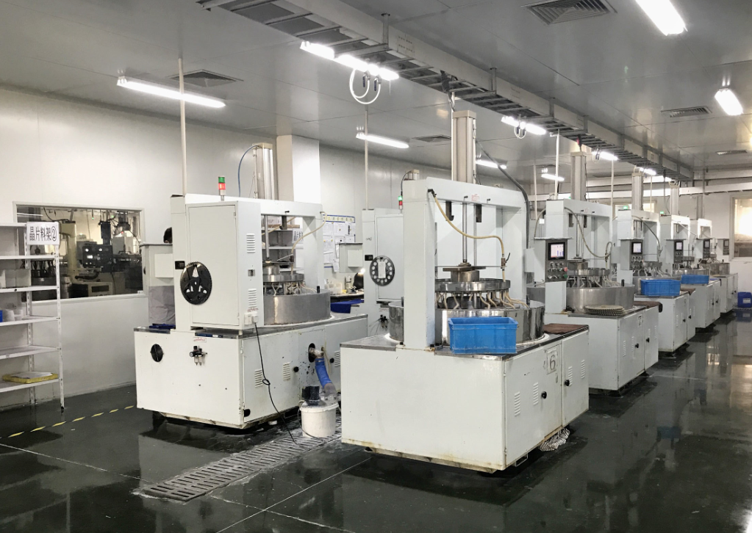
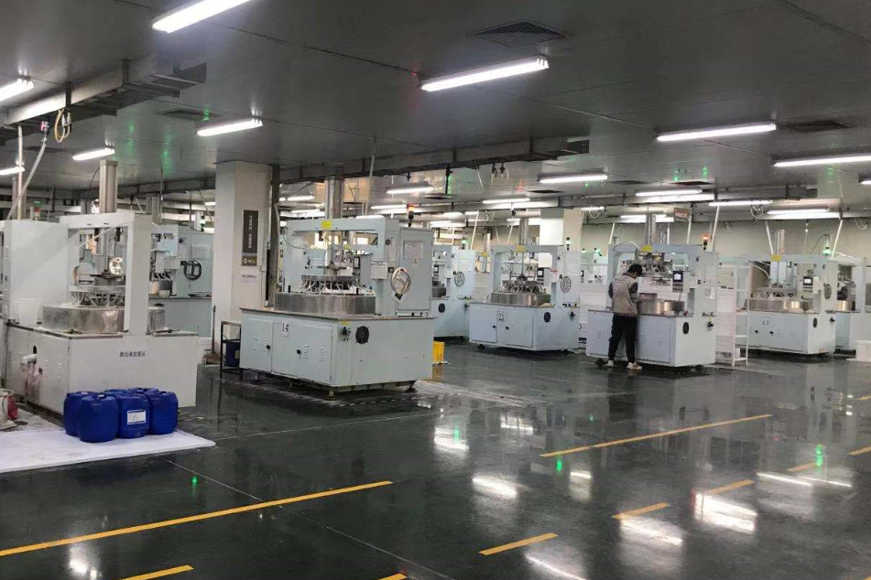
抛 光
Polishing

Slide 37
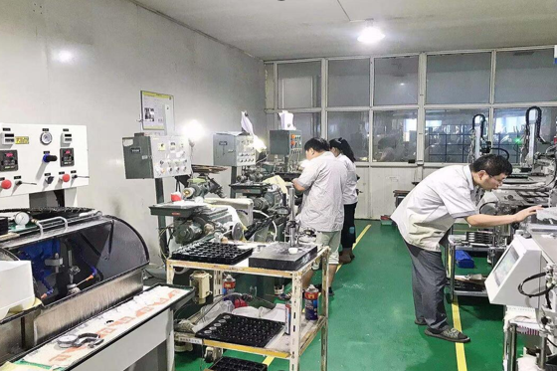
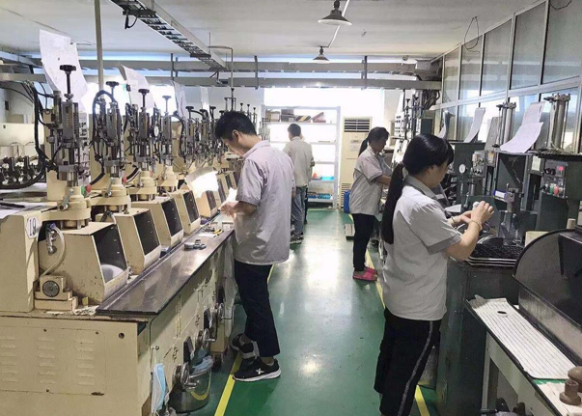
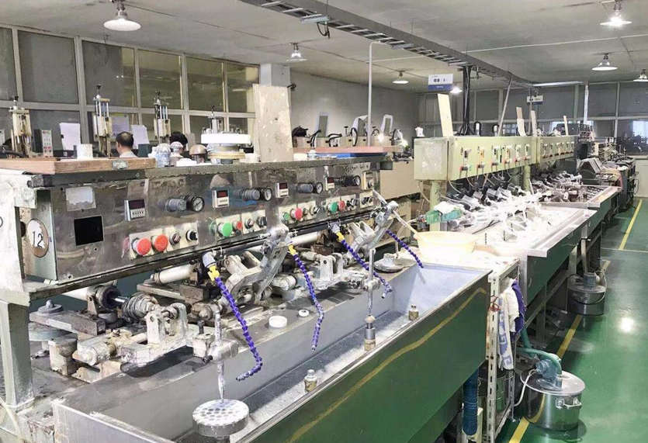
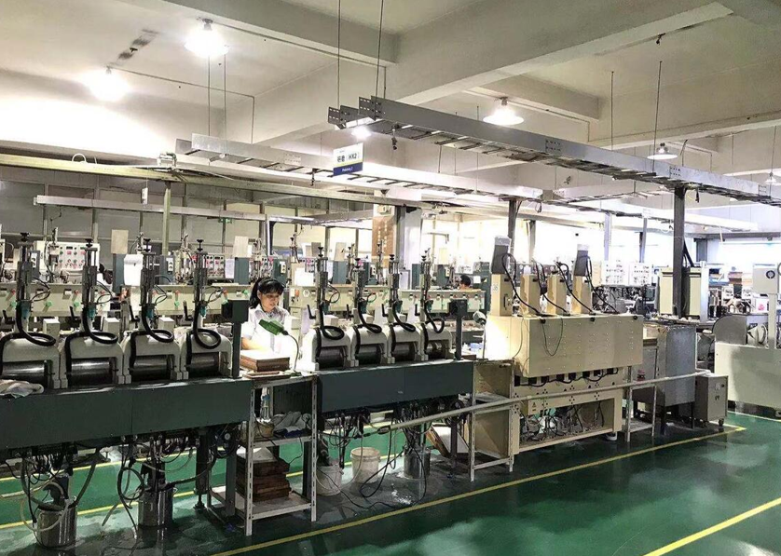
透镜生产线
Optical lens production line
铣磨
Grinding
精磨
Fine grinding
成盘
Grinding
抛光
Polishing

Slide 38
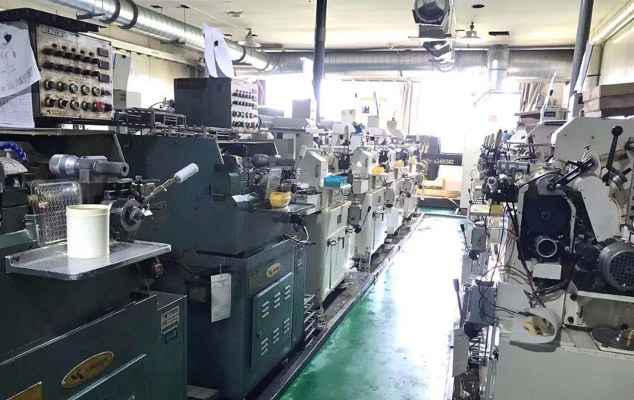
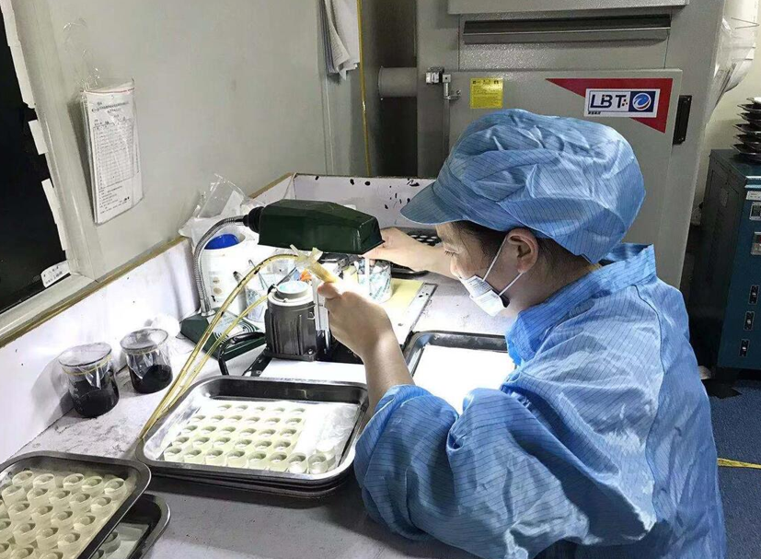
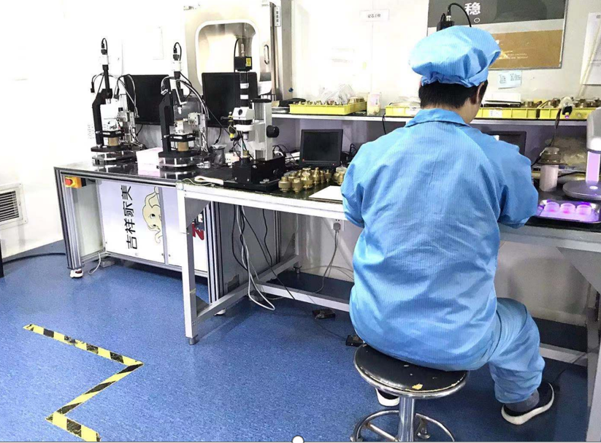
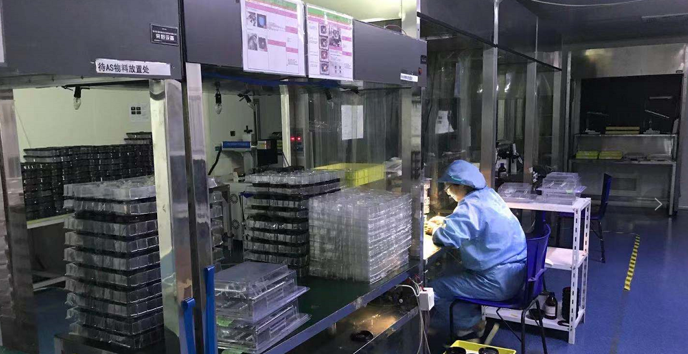
透镜生产线
Optical lens production line
芯取
Edging
涂膜
Inking
胶合
Cement
组装
Assembly

Slide 39
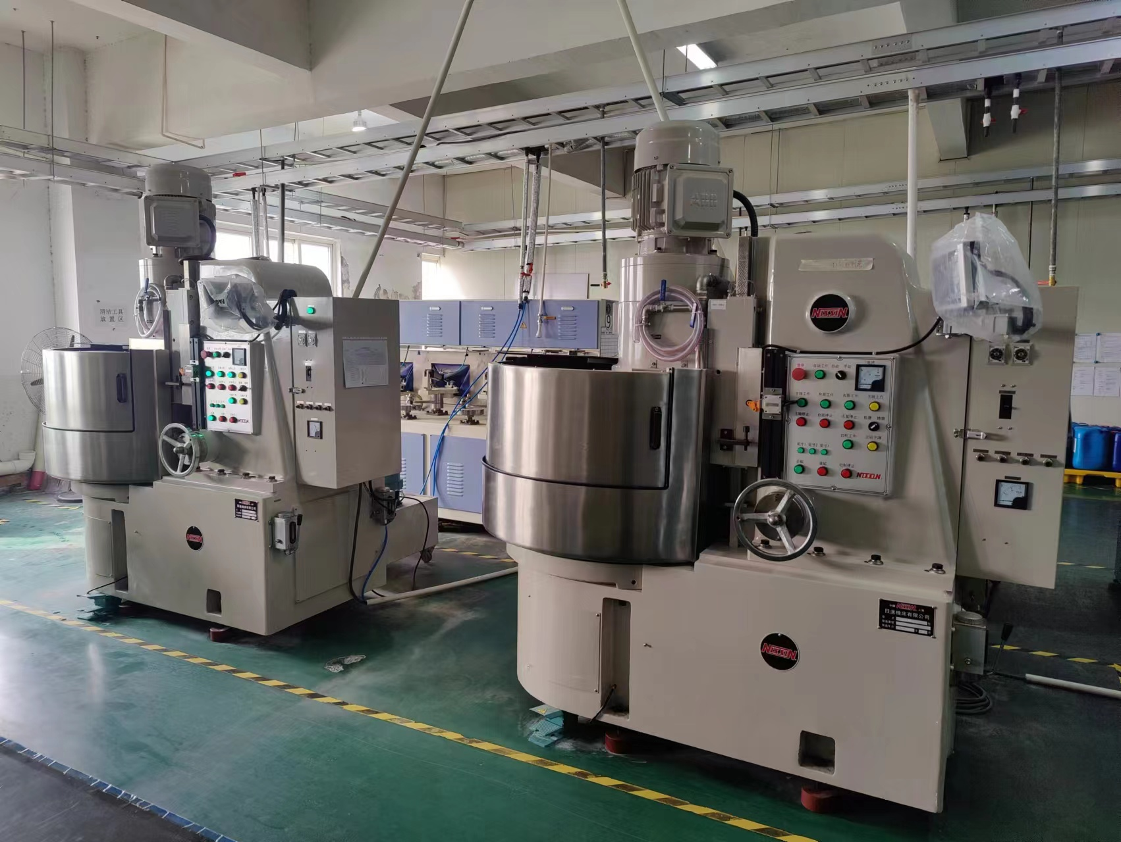
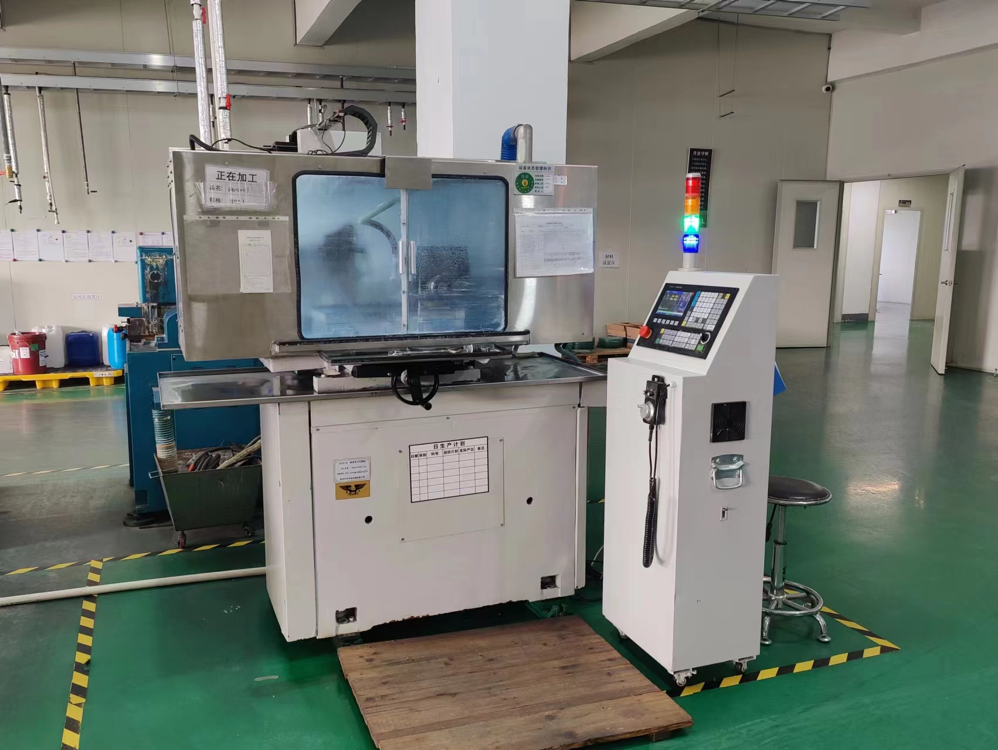
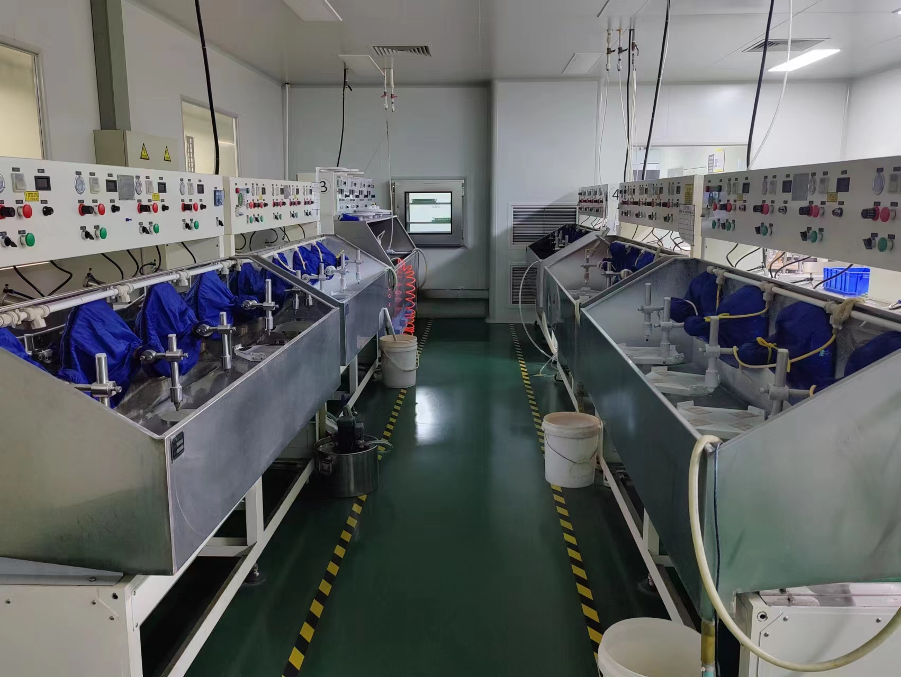
棱镜生产线
Prism production line

Slide 40
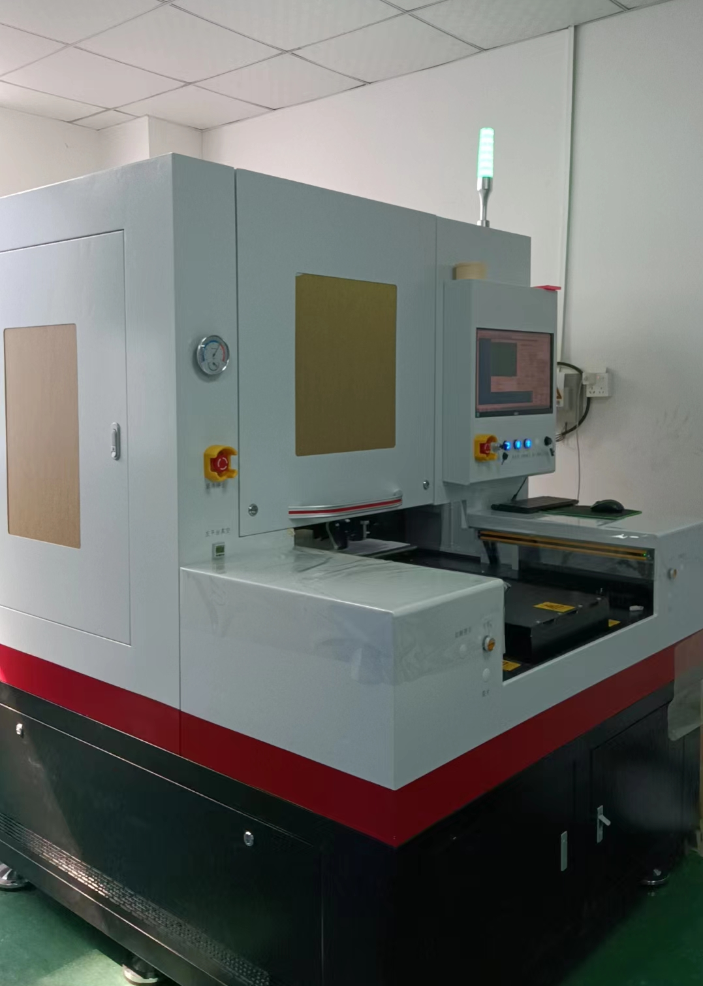
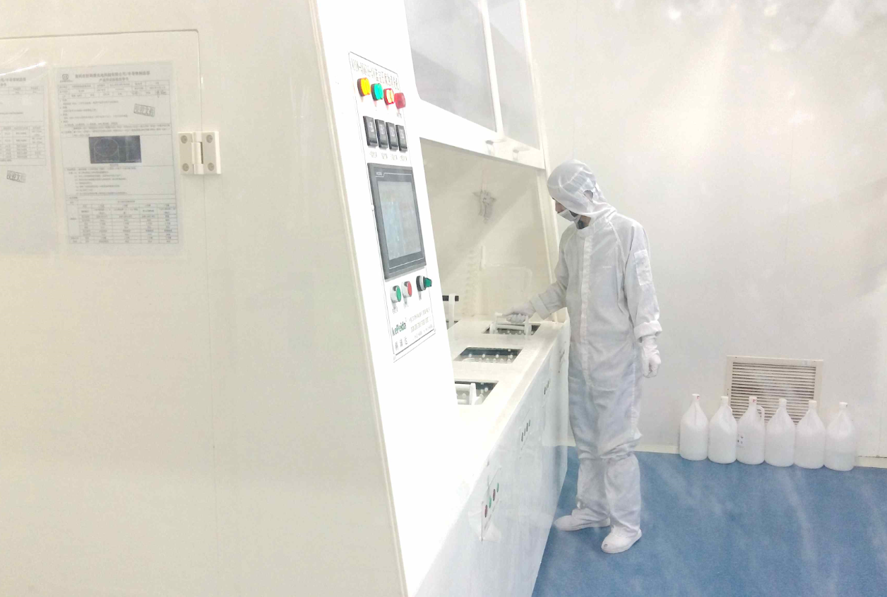
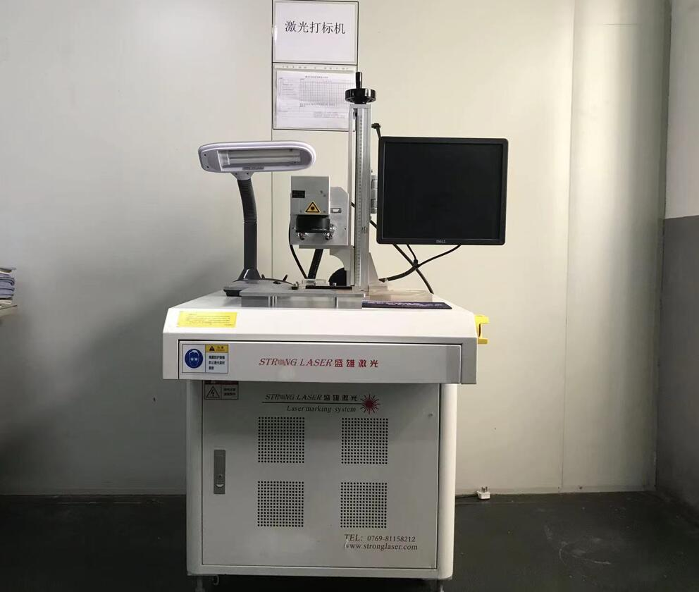
激光切割&化学腐蚀&激光打标
Laser cutting& Chemical etching&Laser marking

Slide 41
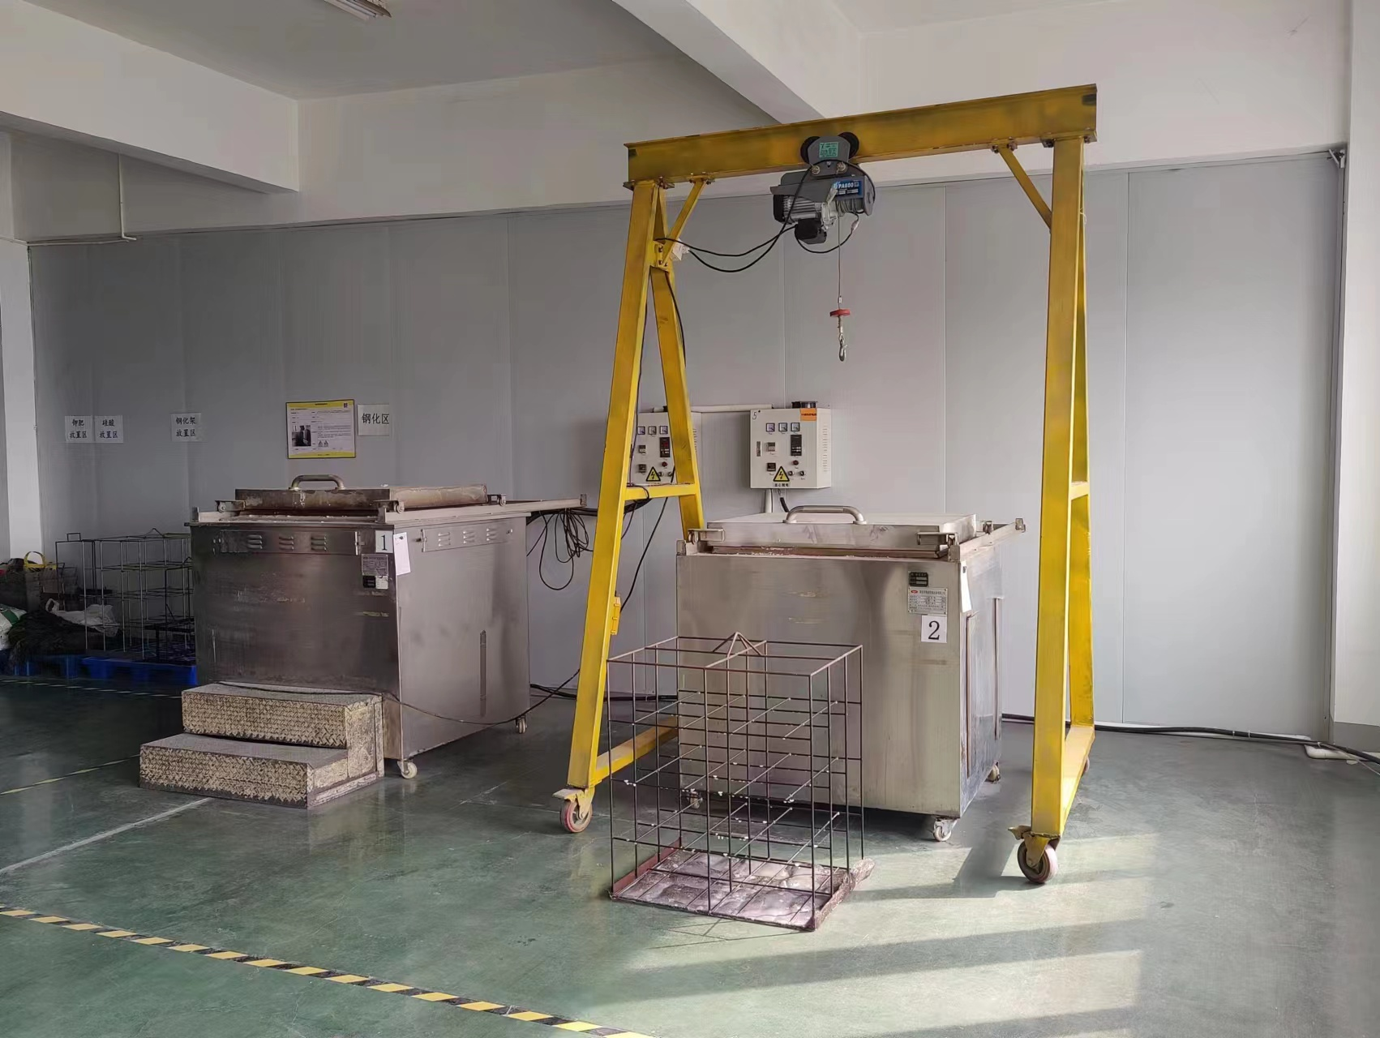
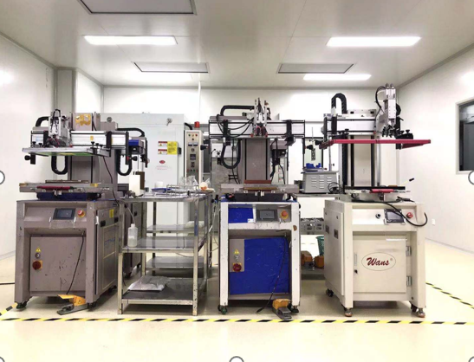
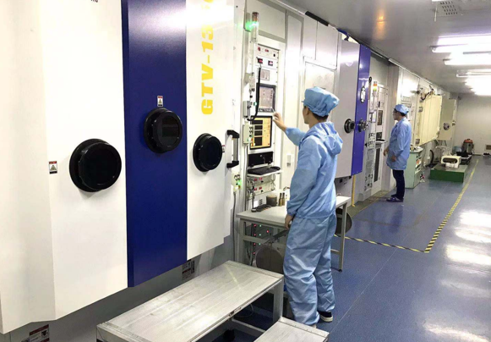
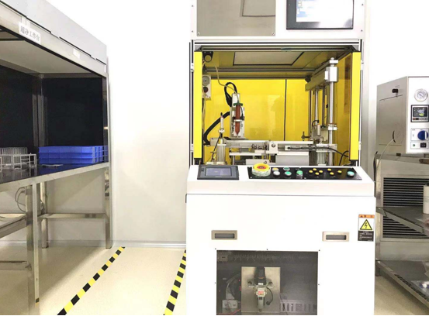
钢化&丝印 & 镀膜 & 贴合
Toughening & Silk printing& Coating & Bonding

Slide 42
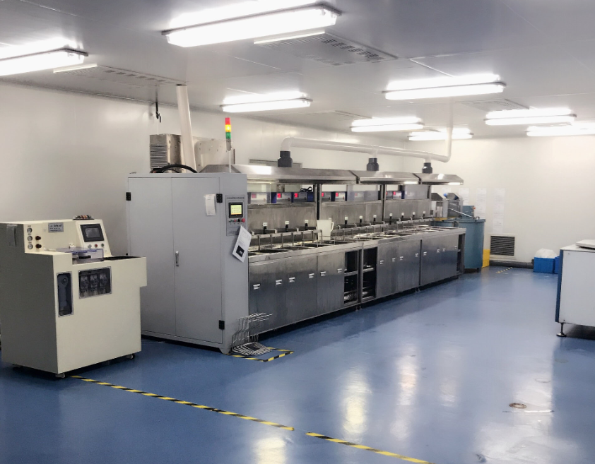
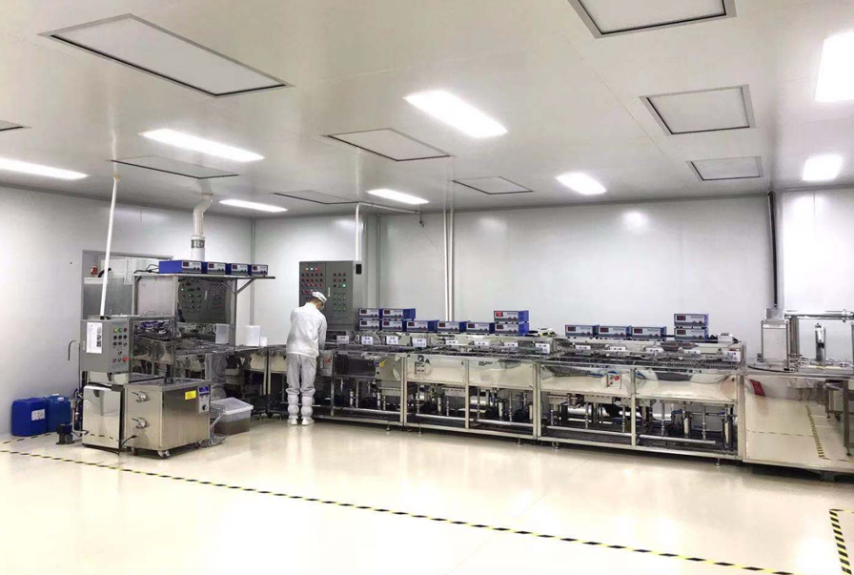
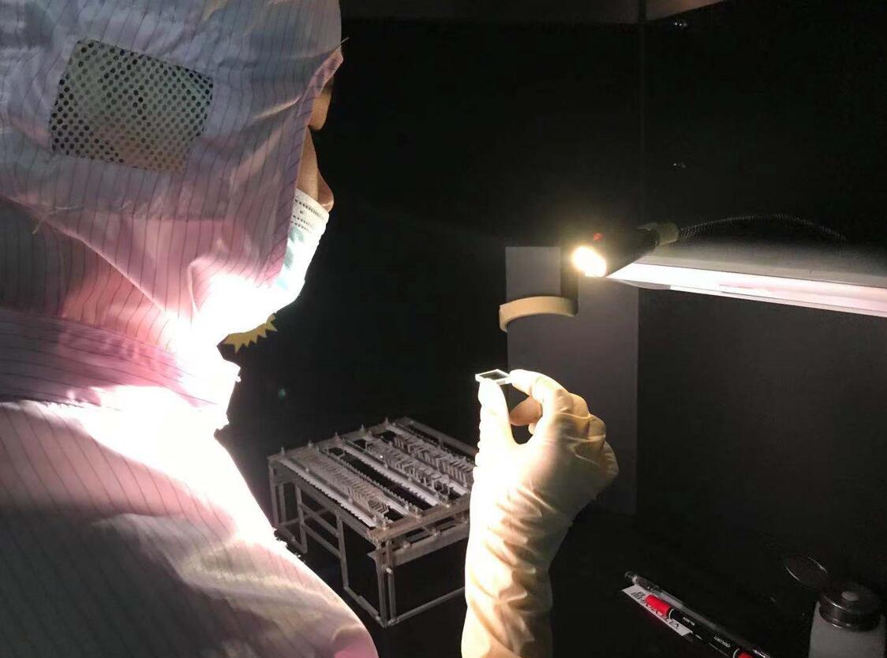
清洗 & 检验
Cleaning & Inspection

Slide 43
检测设备
Inspection device
平坦度测量
平坦度检测仪
Flatness Detector
高精度非接触测量仪 Non-contact flatness inspector
平面度检测仪
Flatness test instrument
轮廓测量
二次元投影仪 Quadratic element projector
3D 投影测量仪
Contourgraph
三坐标测试仪
Coordinate Measuring Machine

Slide 44
检测设备
Inspection device
面型测量
ZYGO干涉仪
ZYGO Interferometer
激光干涉仪
Laser interferometer
分光测量
Carry 7000全能型分光光度计
Carry 7000 Omnipotent Spectrophotometer
分光仪 Spectrophotometer

Slide 45
检测设备
Inspection device
信赖性测试
高低温冲击测试机
High and Low Temperature Test Chamber
高低温湿热试验箱
High and Low Temperature Damp Heat Test Chamber
气密检测仪
Airtightness Detector
震动仪
Vibration Meter

Slide 46
检测设备
Inspection device
表面外观检测
破坏性测试
显微镜
Microscope
广视野显微镜 Macro Inspection System
落球冲击试验机
Falling ball impact test machine
粗糙度检测
AFM原子力显微镜
Atomic force microscope
手持式粗糙度测试仪
Handheld Roughness Tester
单压试验机
Compression testing machine

Slide 47
检测设备
Inspection device
其他
V棱镜折射仪
V-prism Refractometer
应力仪
Stress Meter
光学测角比较仪
Optical Angle Comparator
定向仪
Orientation Device
偏芯仪
Core Deviator
水滴角测试仪
Water Droplet Angle Tester

Slide 48
业务分布
产品畅销国内外，出口欧洲（荷兰，瑞 士、德国）、美国、 以色列、新加坡、马来西亚、台湾、日本、韩国等20多个国家和地区。
Our products have achieved a good sales record both in China and overses market, products been exported to over 20 contries in EU, the USA, Japan, Isreal ,South Korea and South Asia Etc.
Distribution

Slide 49
研发与创新
R&D and innovation
异形棱镜
customized prism
化学蚀刻
chemical etching

↑

→


↑

→

大尺寸超薄晶圆、
玻璃通孔TGV
large dimesion semi wafer, glass wafer TGV
光学镀膜
Coating for high power laser film , IR film, dielectric film and light-spliting film.
激光加工
Photolighography

↑

→


↑

→

在开发的产品及工艺:
大尺寸超薄晶圆，玻璃晶圆TGV ，异型棱镜，激光/化学蚀刻,光刻, 镀膜（高功率激光膜，截止膜，介质膜，分光膜)。
Product and technology which under the R&D covers fabricate large dimesion semi wafer, glass wafer TGV ,customized prism , laser etching ,chemical etching ,Photolithography and coating, this may including high power laser film , IR film, dielectric film and light-spliting film.

Slide 50
二期生产大楼效果图 （大尺寸晶圆）
Design sketch of production buidling
*建筑面积13750 平米(3层）
Covers floor area of13750 square
meters and 3 floors in total.
*一楼晶圆研抛车间
Wafer polishing workshop in the
1st floor
*二楼晶圆镀膜车间
Wafer coating workshop in the
2ed floor.
*三楼场地预留
Reserve empty space in the 3rd
floor for production expansion.
晶圆设备规划
Wafer production device planning

Slide 51
联系我们
Contact Us
江苏省常州市新北区罗溪镇旺财路10号
No : 10 wangcai road, Luoxi town, Xinbei district, Changzhou, Jiangsu, China.
Tel: 86-519-83200018
Fax: 86-519-83408000
Website: www.cnhll.com
Email: sales@cnhll.com

Slide 52
Thanks
谢谢您的观看

